Slide 1


Memory Game M6 We Can Remember it for You Wholesale

Slide 2


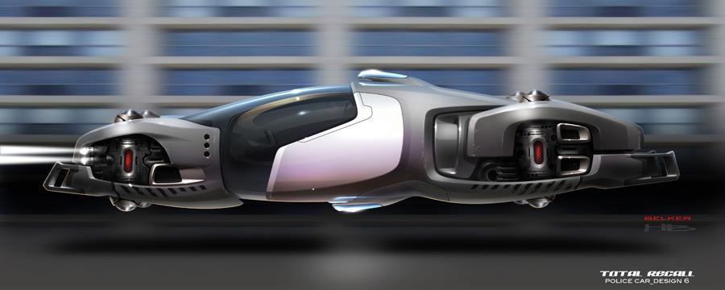

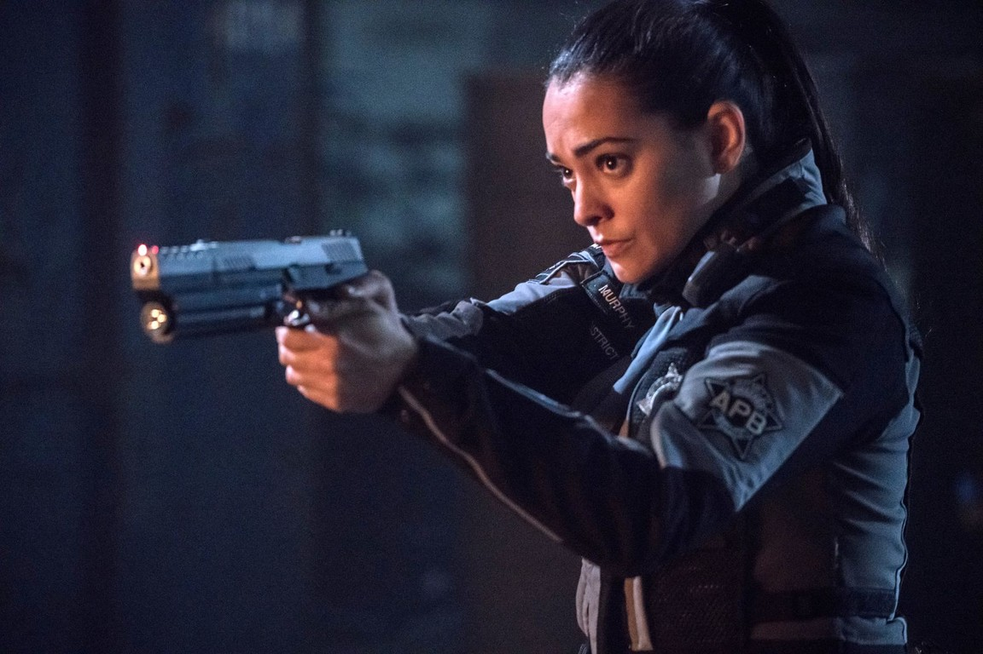
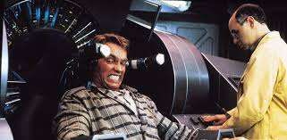
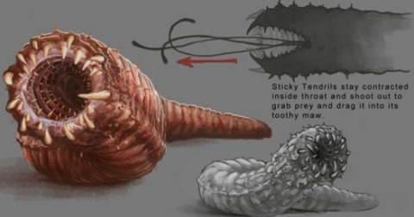
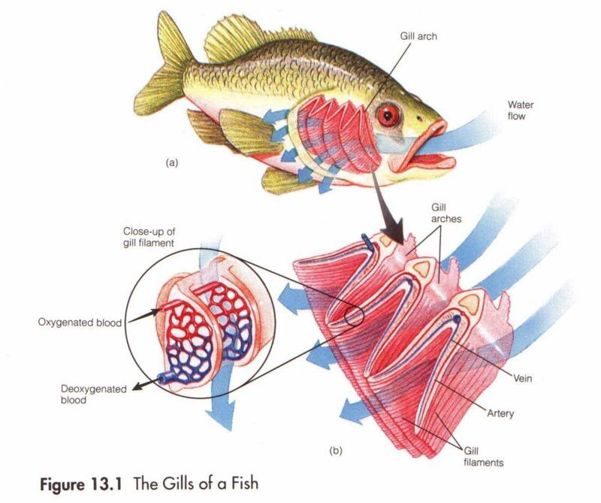
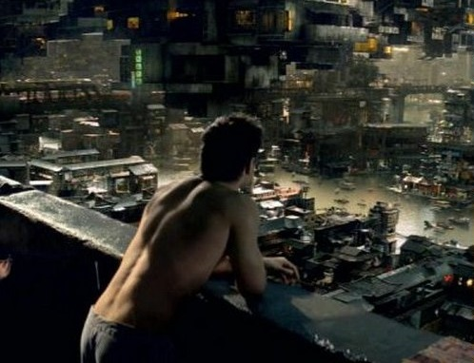
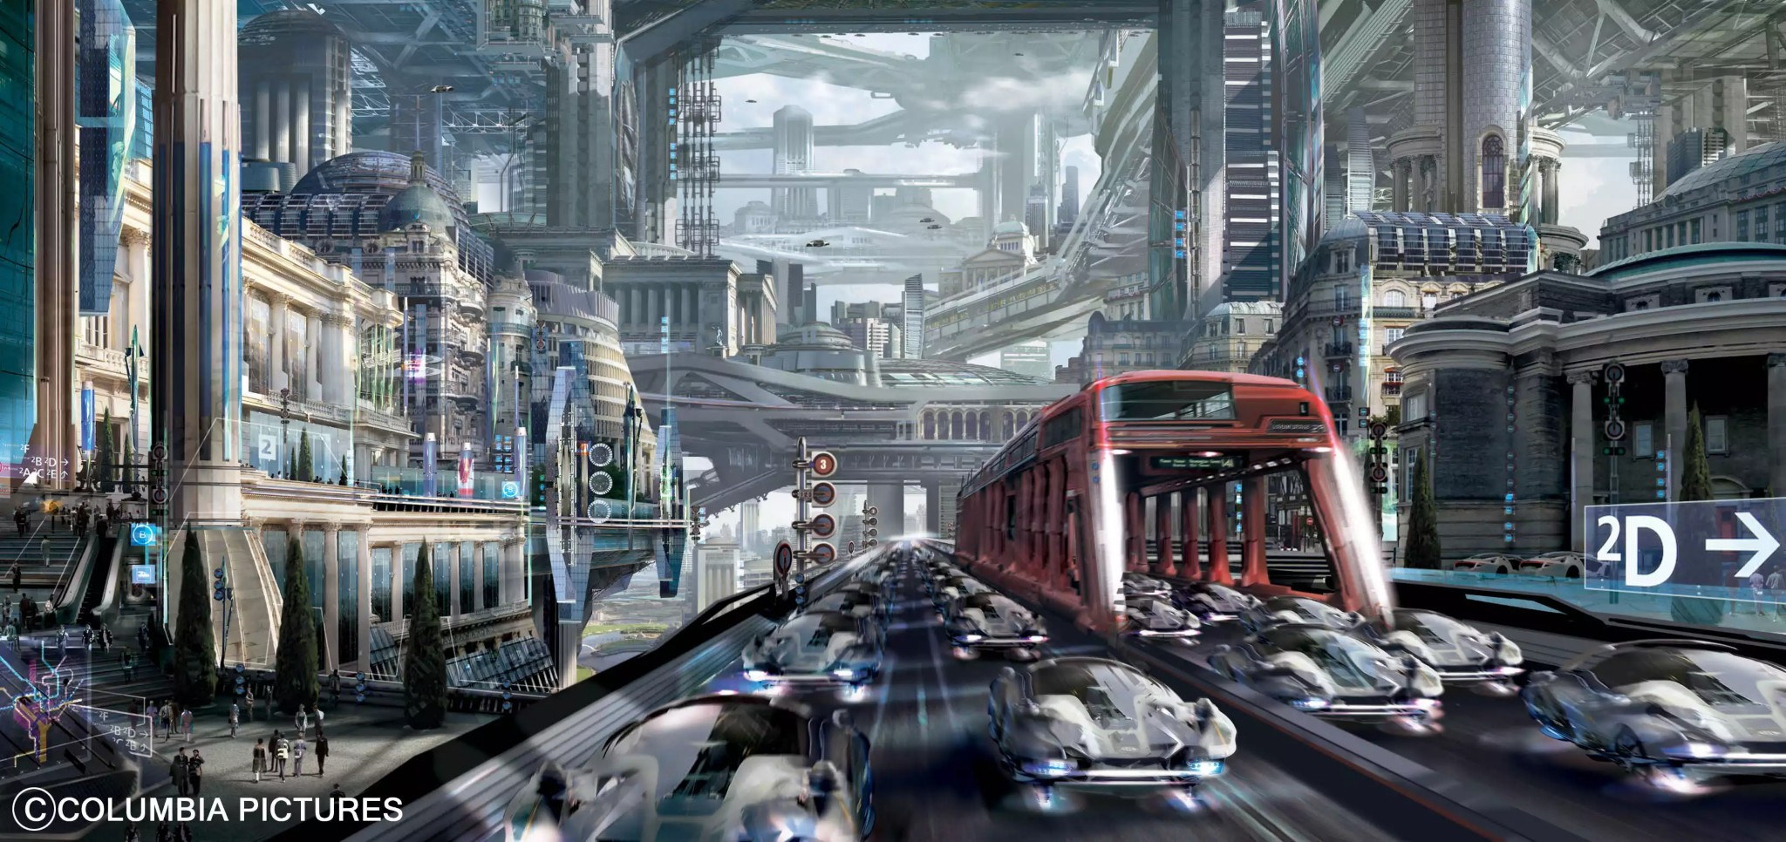
1A
1B
Maw Worm
1C
Rekal
1D
Interplan
1E
Conapt
2A
2B
2C
Runnel
2D
2E
Gill
3A
3B
3C
Hover Car
3D
3E
4A
4B
Poscreds
4C
4D
Homeopapes
4E
Miserable office worker

